Slide 1
Notes:
There are times when we want to represent different kinds of data under a single, collective umbrella. Here are a few examples:
A traffic light can be in different states: red, yellow, or green.
Yes, in some countries there are different or more colors and color-combinations.
Collectively, they represent one thing: a new type called a traffic light state.
A zoo consists of many kinds of animals. Collectively, they represent one thing: a new type called an animal. Some condition determine which particular kind of animal a zookeeper might be dealing with.
A social network consists of different kinds of pages. Some pages represent individual humans, some places, some organizations, some might stand for activities, and so on. Collectively, they represent a new type: a social media page.
We call these “conditional” data because they represent an “or”: a traffic light is red or green or yellow; a social medium’s page is for a person or location or organization; and so on. Sometimes we care exactly which kind of thing we’re looking at: a driver behaves differently on different colors, and a zookeeper feeds each animal differently. At other times, we might not care: if we’re just counting how many traffic lights or on, how many animals are in the zoo, or how many pages are on a social network, the exact nature of it doesn’t matter. Therefore, there are times when we ignore the conditional and treat the datum as a member of the collective, and other times when we do care about the conditional and do different things depending on the individual datum. We will make all this concrete as we start to write programs.

Slide 2
Do Now:
data ITunesSong: song(name :: String,
singer :: String,
Year :: Number) end
lver = song("La Vie en Rose", "Édith Piaf", 1945)
so = song("Stressed Out", "twenty one pilots", 2015)
wnkkhs = song("Waqt Ne Kiya Kya Haseen Sitam",
"Geeta Dutt",
1959)
#What happens if we instead write this?
lver :: String = song("La Vie en Rose", "Édith Piaf", 1945)
#What error do we get? How about if instead we write these?
lver :: song = song("La Vie en Rose", "Édith Piaf", 1945)
lver :: 1 = song("La Vie en Rose", "Édith Piaf", 1945)

Slide 3
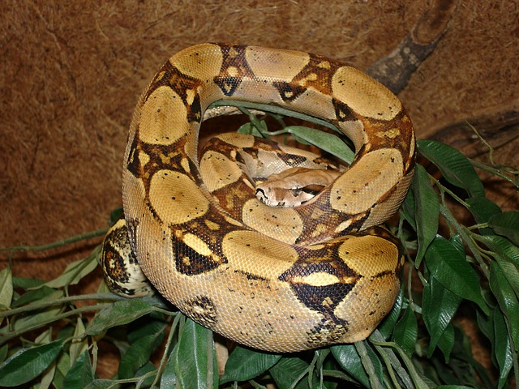
a Boa
is a boa(string, number, string)
data Boa:
boa(name :: String,
length :: Number,
eats :: String)
end

Slide 4
a boa is a boa(String, Number, String)
data Boa:
boa(name :: String, length :: Number, eats :: String)
end
B1 = boa("Slinky", 30, "pets")
B2 = boa("Slim", 50, "homework")

Slide 5
data definitions also create functions
data Boa:
boa(name :: String, length :: Number, eats :: String)
end
# Boa constructor function
# boa : String Number String -> Boa
B1 = boa("Slinky", 30, "pets")

Slide 6
data definitions also create functions
data Boa:
boa(name :: String, length :: Number, eats :: String)
end
# Boa accessor functions
# nameOfBoa.name : Boa -> String
# nameOfBoa.length : Boa -> Number
# nameOfBoa.eats : Boa -> String
B2 = boa("Slim", 50, "homework")
B2.name -> “Slim”
B2.length -> 50
B2.eats -> “homework”

Slide 7
data definitions also create functions
data Boa:
boa(name :: String, length :: Number, eats :: String)
end
# Boa predicate function
# is-boa: Data -> Boolean
B2 = boa("Slim", 50, "homework")
is-boa(B2) -> true

Slide 8
write 3 examples of boa-fit-cage
fun boa-fit-cage(aboa :: Boa, limit :: Number) -> Boolean:
doc: “consumes a boa and a limit and produces true if the boa will fit inside the cage, false if it will not”

Slide 9
write 3 examples of boa-fit-cage
fun boa-fit-cage(aboa :: Boa, limit :: Number) -> Boolean:
doc: “consumes a boa and a limit and produces true if the boa will fit inside the cage, false if it will not”
aboa.length <= limit
end
check:
boa-fit-cage(B2), 10) is false
boa-fit-cage(boa("Slinky", 30, "pets"), 30) is true
boa-fit-cage(boa(“Slinky”, 30, “pets”), 55) is true
end

Slide 10
# a dillo is a dillo(number, boolean)
data Armadillo:
| dillo(length :: Number, dead :: Boolean)
end
D1 = dillo(20, true)
D2 = dillo(5, false)

Slide 11
# hit-with-truck: dillo -> dillo
# return dead dillo one unit longer than given dillo
Define the rest of this function using the design recipe. Write a function header, examples, and a function body.

Slide 12
# hit-with-truck: dillo -> dillo
# return dead dillo one unit longer than given dillo
Define the rest of this function using the design recipe. Write a function header, examples, and a function body.

Slide 13
# a tiger is a tiger(string, number, product)
# a product is a product(string, string)
data Product:
| product(item :: String, company :: String)
end
# a tiger is a tiger(string, number, product)
data Tiger:
| tiger(name :: String, length :: Number, sells :: Product)
end

Slide 14
# a tiger is a tiger(string, number, product)
Design a function called sells-gas, which returns true if a given tiger sells gas

Slide 15
Data can combine other data
# a Product is a product(String, String)
data Product: product(item :: String,
company :: String)
end
# a Tiger is a tiger(String, Number, Product)
data Tiger: tiger(name :: String,
length :: Number,
sells :: Product)
end

Slide 16
Data can combine other data
# a Product is a product(String, String)
data Product: product(item :: String,
company :: String)
end
# a Tiger is a tiger(String, Number, Product)
data Tiger: tiger(name :: String,
length :: Number,
sells :: Product)
end
Constructor functions

Slide 17
Data can combine other data
# a Product is a product(String, String)
data Product: product(item :: String,
company :: String)
end
# a Tiger is a tiger(String, Number, Product)
data Tiger: tiger(name :: String,
length :: Number,
sells :: Product)
end
Fields,
parameters of constructor functions

Slide 19
Data can combine other data
# a Date is a date(Number, Number, Number)
data Date: date(year :: Number,
month :: Number,
day :: Number)
end
# an Email is an email(String, String, String, Date)
data Email: email(sender :: String,
subject :: String,
body :: String,
date :: Date)
end

Slide 20
Data can be conditional
A traffic light can be in different states: red, yellow, or green.
Collectively, they represent one thing: a new type called
a Traffic Light State.
A zoo consists of many kinds of animals.
Collectively, they represent one thing: a new type called
an Animal.
A social network consists of different kinds of pages.
Collectively, they represent a new type:
a Social Media Page.

Slide 21
Traffic Light State
data TLState:
| Red
| Yellow
| Green
end

Slide 22
Traffic Light State
data TLState:
| Red
| Yellow
| Green
end
A traffic light can be Red or Yellow or Green

Slide 23
Traffic Light State
data TLState:
| Red
| Yellow
| Green
end
The stick | is needed when you have different variants of the data.

Slide 24
Traffic Light State
data TLState:
| Red
| Yellow
| Green
end
Should we consider these variants to be functions or values or types?

Slide 25
Traffic Light State
data TLState:
| Red
| Yellow
| Green
end
Should we consider these variants to be functions or values or types?
Yes

Slide 26
Data can be conditional and structured
data Animal:
| boa(name :: String,
length :: Number,
eats :: String)
| tiger(name :: String,
length :: Number,
sells :: Product)
| dillo(length :: Number,
dead :: Boolean)
end

Slide 27
Due by end of period
There is a permissions problem with shared Pyret files. I sent you an email about it. Copy and paste your video game code into the file I shared with you.
Type your checks into the Pyret file I sent you for the 04.00 Formative Assignment. I will check your work in your Pyret file.

Slide 28
Tomorrow
I will give you 10 minutes at the end of class tomorrow to finish typing in your 04.00 assignment.
Tomorrow, the final type of data structure this year -- collective data.

